Slide 1

Virtual Adventures for Youth Ministry
“We Each Have Something to Contribute”
Notes:
Suggestions for use:
Begin by starting Zoom or other video conferencing system and welcoming everyone.
Once welcome is complete,
Click the “Share Screen function within Zoom
Before you share, make sure both of the options, which can be found on the bottom of the screen, are checked: “Share computer sound” and “Optimize screen share for video clip,” then click “share screen.
The share screen will open, locate the PowerPoint, click it and then click “share.”
Once the screen is shared, click into PowerPoint and turn on the slide show so it shows full screen.
Slide 1 is the introduction – you may want to share the title

Slide 2
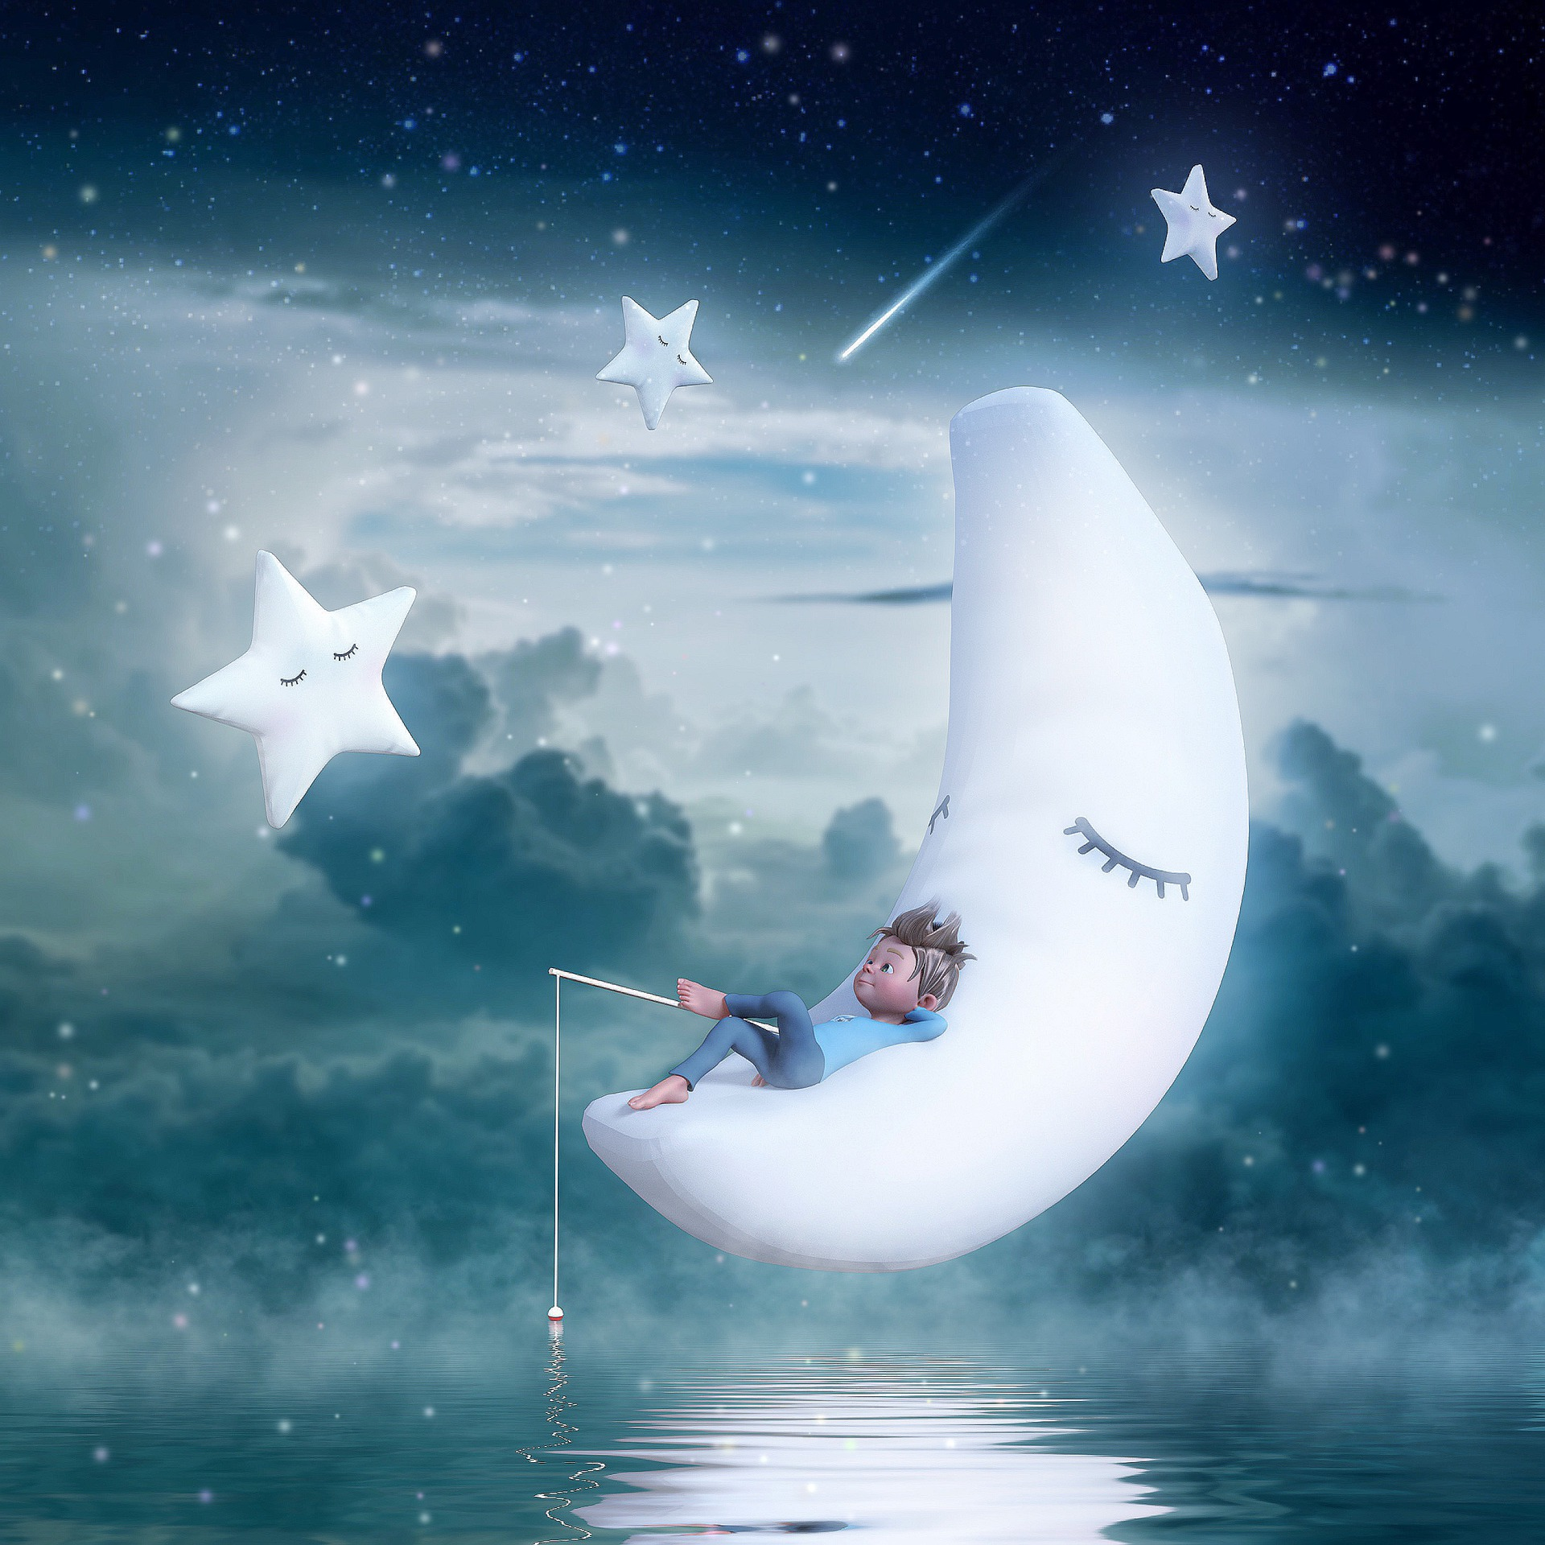

Setting the Stage
Frederick the mouse appeared to be doing nothing, but he was really doing what he does best!
Notes:
This slide introduces the story and a sentence about the story focus.

Slide 3


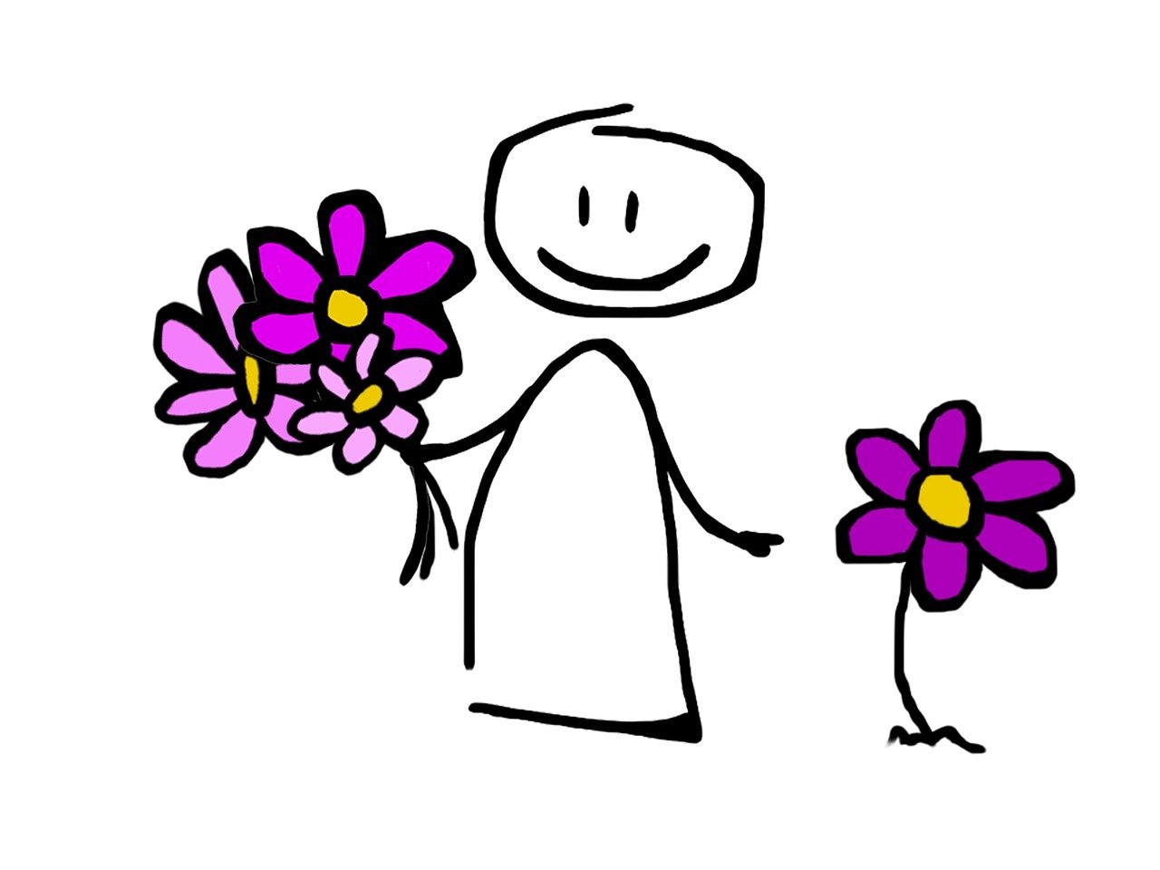
Building Community
You are invited to draw a picture of something you like about yourself.
And/Or
You are invited to write in the chat, something you like about yourself.
Notes:
This slides introduces the community building activities. Tell the children that in a moment they will have the opportunity to draw or write about that they love about themselves.
Invite them to use the Chat feature to write about themselves. While they are posting in the chat…
Go to the next slide and invite them to use the “Annotate” feature to draw something they like about themselves.

Slide 4
Draw something you like about yourself.
Notes:
When this slide loads, click the “Annotate” button at the top. A set of tools will open.
Invite the children to also click the “Annotate” button and invite them to draw a picture of something they like about themselves
When the children are finished – you can save the slide, if you chose, by clicking on the ”save” button on the annotation tool bar. It will be saved to your computer.

Slide 5

Frederick, by Leo Lionni
Notes:
Share the story by either playing the video within the PowerPoint or click the Youtube link and watch online.
https://www.youtube.com/watch?v=qd2zaLyaCJM&feature=emb_logo

Slide 6

Discussion
When the story began what were the mice doing?
What was Frederick doing?
What did the mice decide about Frederick?
At the end, how did Frederick surprise them?
What special skill do you have that helps others?
Notes:
Once the video is complete, engage the children in a brief discussion about the story.

Slide 7
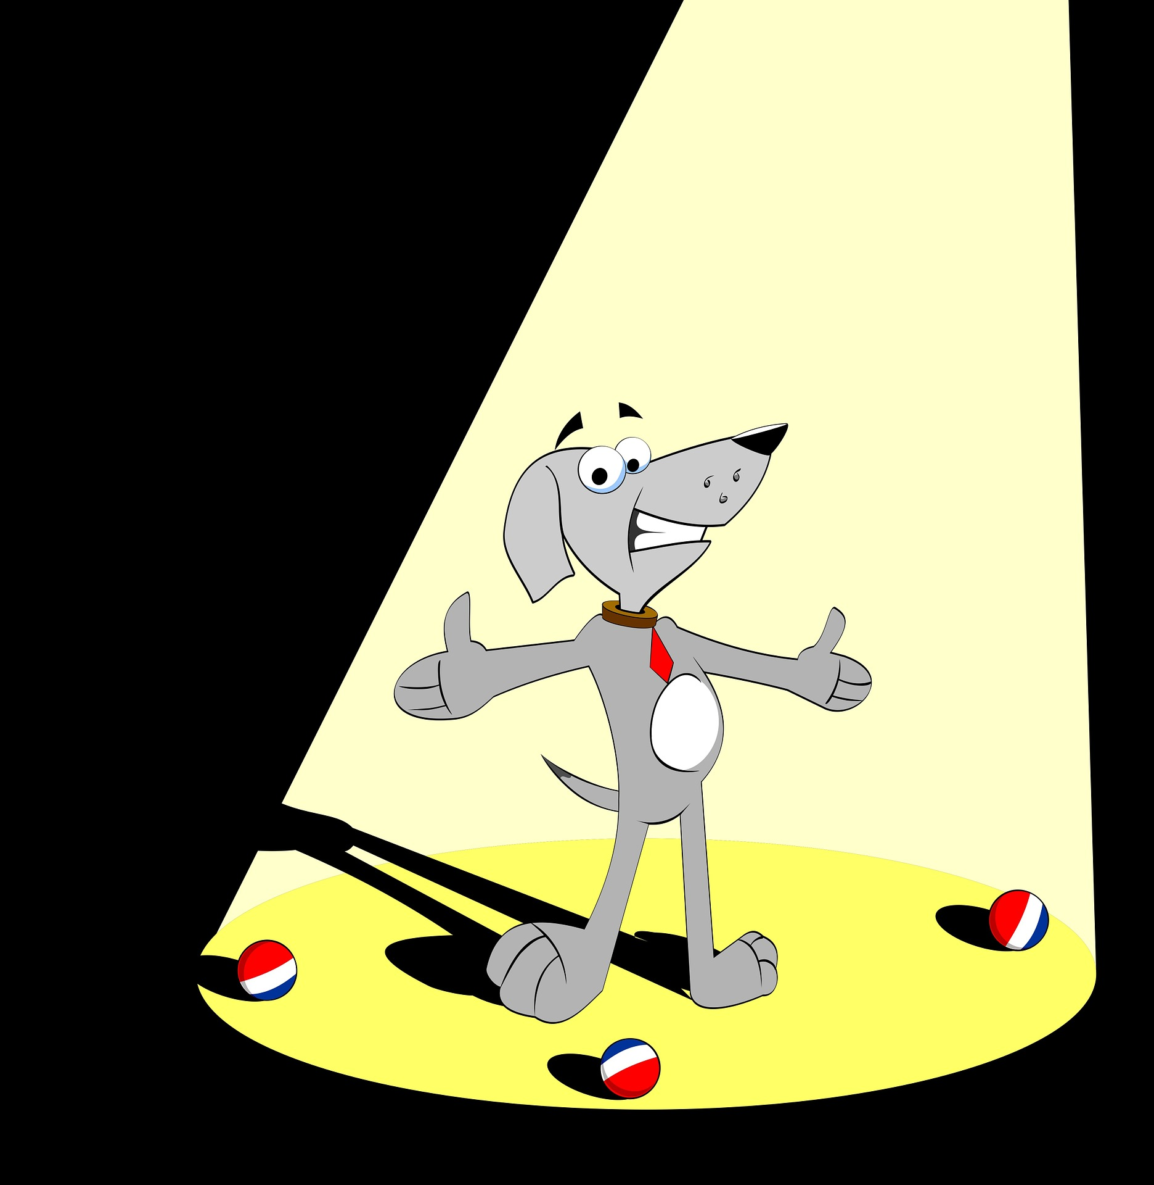
Activity:
Online Talent Show
Instructions
Think about a talent you have. It can be something as simple as doing exercises, coloring or playing a video game to music and art.
Let’s take turns sharing our talents. You can turn your video on to share it.
Think about how your talent might be used for good in the world.
Notes:
For this activity, you may want to stop the screen share so all videos are more visible.
Ask the children to think about a talent they have. It can be something as simple as doing exercises, coloring or playing a video game to music and art.
Invite them, one by one, to share or demonstrate their talent by turning on their camera. You may want to use the ”raise hand” feature which can be found in the participant panel.
Encourage them to consider how their talent might be used for good in the world.
Once the sharing is done, share your screen again to access the final slide.

Slide 8


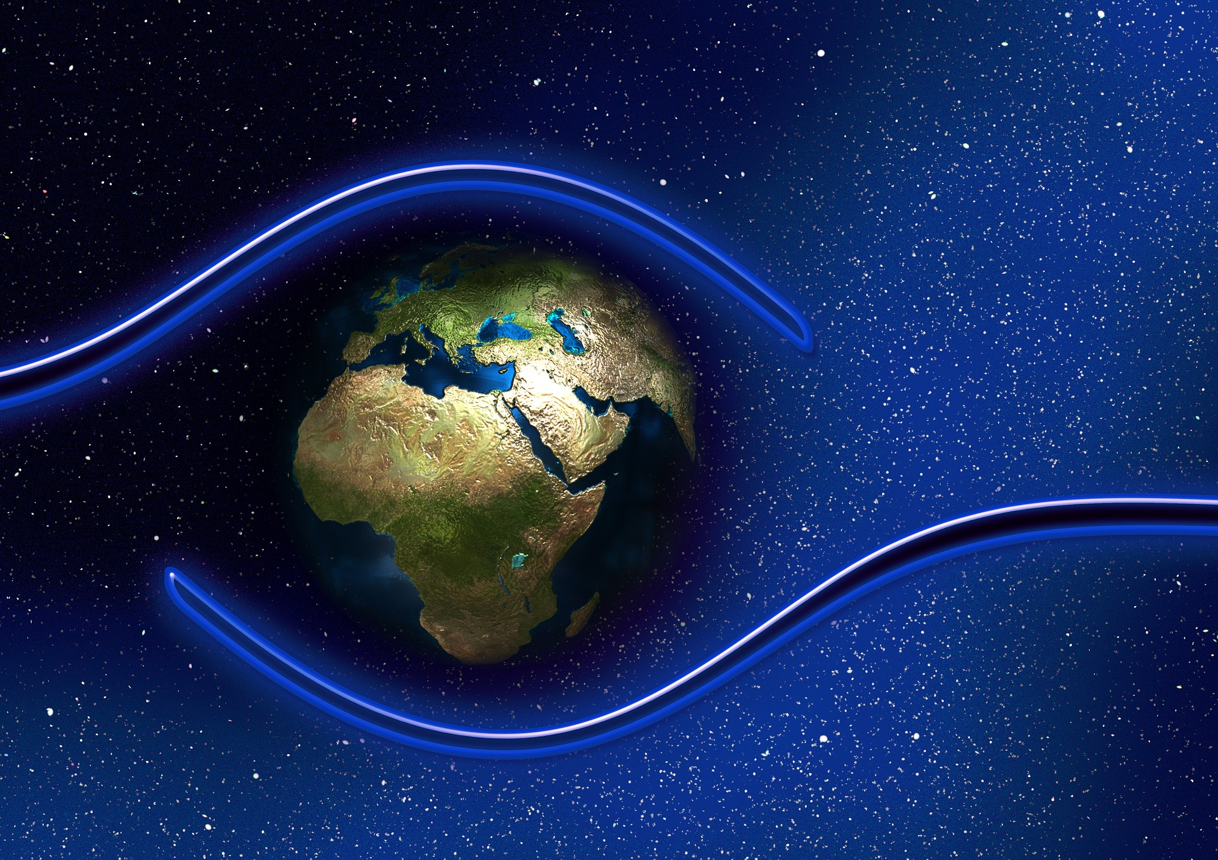




Prayer for Protection
The Light of God surrounds us
The Love of God enfolds us
The Power of God protects us
The Presence of God watches over us
Wherever we are God IS! And all is well!
Notes:
Share the Prayer for Protection.
Also include other closing activities that are traditionally done in your ministry, if appropriate.

